Slide 1
Expectations and Requirements
Advanced Practical Course – Next Generation Data Center Operations for SAP Enterprise Software (IN2128, IN2106, IN212810)
Simon Fuchs, Maximilian Niedermeier, Noah Kim, Leon Kist
Summer Semester 2026

Slide 2
Agenda
Expectations & Requirements
Group Phase
Presentations
Project Documentation

Slide 3
Group Phase

Slide 4
Working together
Group Phase
Group work
Three to Four group members
Define different profiles
Do not think about implementation alone, also about presentation, organization and documentation
Communicate who had which profile and who did what
Everybody has to contribute his/her fair share
Use standardized solutions/technology
Better a standard solution than a self-crafted
Existing documentation that you can link to is documentation that you don’t have to write yourselves
General Behaviour
Be creative! – No Kindergarten!
Engage problems in teams early
Try to solve problems internally
Get in contact with the course organizers early, if you can’t solve the problems internally
Think of yourselves as a consulting team helping the course teachers as your customers
Notes:
4

Slide 5

Meeting Etiquette
General Expectations
In Meetings with supervisors (and external partners)
Turn on your camera!
Be on-time
Have some slides or a demo prepared
Send your questions previously to the supervisors/partners such that they can prepare
Speak to show that you are available and considerate
Split up the speaking parts
Source: https://de.wikipedia.org/wiki/Datei:Microsoft_Office_Teams_%282025%E2%80%93present%29.svg
Notes:
5

Slide 6

Project Management
General Expectations
Define profiles and work packages
Document both
Present the profiles
Decide/determine a project lead or project manager
Schedule regular meetings
Early engage members and work not meeting the requirements
Write a project plan (when do we do what) → present it in the intermediate presentation
Regularly update your topic supervisor (=customer)
Actively contact your topic supervisors, don’t wait until they contact you
Source: https://img.freepik.com/free-vector/hand-drawn-business-planning-concept_52683-75727.jpg?semt=ais_hybrid&w=740&q=80
Notes:
6

Slide 7
Presentations

Slide 8
Motivation
Presentations
Why are presentations important?

Slide 9
Motivation
Presentations
Why are presentations important?
Disseminate information efficiently
Engaging
Interactive
Ensure participation
…

Slide 10
Motivation
Presentations
Why are presentation skills important?

Slide 11
Motivation
Presentations
Why are presentation skills important?
(Almost) Everybody has to present things:
To your team
To your boss
To customers
To potential customers

Slide 12
Motivation
Presentations
Why are presentation skills important?
Impressions matter!
Ensure you are heard and remembered:
Prevent your contributions from being overlooked
(by your boss)
Customers understand their system & your worth
Get hired (employers & customers)

Slide 13
Motivation
Presentations
Final Grade
10%
20%
70%
General Impression
Project Phase
Knowledge Check
10%
25%
25%
40%
Concept Presentation
Final Presentation
Documentation
Project
7%
17,5%
17,5%
28%

Slide 14
Requirements
Presentations
What are you required to do?
Show up (on time)
Briefly introduce your team (with your respective roles)
Describe your problem and the requirements (of your stakeholders)
Present your solution and its design
Outline your approach and technologies used (or planned)
Show your results (or expected results) in relation to the problem introduced earlier

Slide 15
Expectations
Presentations
What are you expected to do?
Be professional
Tailor your presentation to your audience
→ We are your customers
→ You are an external consultancy group
Tell a concise story
Be prepared

Slide 16
Expectations
Presentations
What are you encouraged to do?
Be creative
Be consistent
Create visually appealing slides
Face the (entire) audience

Slide 17
Negative Examples
Presentations
Who needs that many containers? And Why?
Regular company or datacenter:
Dedicated (on-premise) servers
Even if large number of applications exist → managed directly by teams
Problem: requires know-how, hardware expensive, long setup time, dedicated personal needed, …
Solution → the cloud
What is the cloud?
Applications are hosted externally
Accessed over the internet
(Often) Large dedicated datacenters in strategic locations
Typically charge regular fees or depending on usage
Benefits (for users):
No know-how required (for hardware and hosting) & no hardware costs, Fast/immediate setup, Managed externally → no personnel required, Accessible for small companies (even in emerging markets) or private users, Scaling
Problems (for users):
Dependent on internet access, Security and trust issues, Dependency on providers, Centralized hosting → single point of failure
Typical Services:
Infrastructure as a service (IaaS) → IT infrastructure (e.g., computing, storage, …), Platform as a service (PaaS) → Tools and services to deploy applications (e.g., OS, runtime env., …), Software as a Service (SaaS) → Fully functional applications (e.g., ERP, CRM, …)

Slide 18
Negative Examples
Presentations
Results:
Before the migration, the congestion window size is consistent at values between 200 MB and 170 MB.
After the migration, the congestion window size drops to values of around 150 MB for address translation.
Afterward, it stays consistent.
For QUIC connection migration, the congestion window size drops to values of 50 KB immediately after
the migration. It then increases exponentially for about 5 seconds, since another slow start phase is initiated.
After this, the congestion window increases only linearly for the next 10 seconds. Most likely due to congestion
avoidance. Afterward, the congestion window size remains consistent.

Slide 19
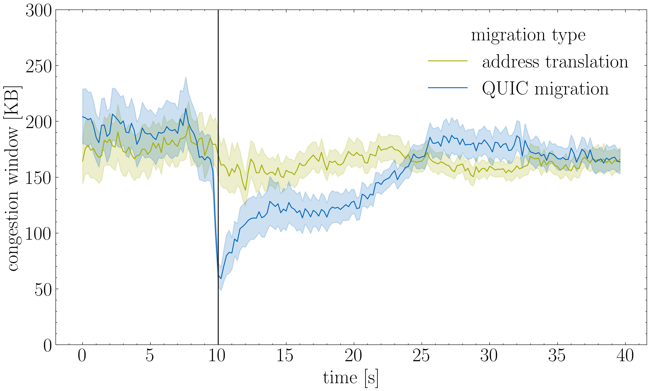
Negative Examples
Presentations

Slide 20
Project Documentation

Slide 21

Guidelines
Project Documentation
What are you encouraged to do?
Be creative
Be consistent
Create visually appealing figures and tables to support your text → “A good figure says more than a thousand words”
Be complete but short
Let other read your documentation and ask them, if they understand it
Source: https://png.pngtree.com/png-vector/20190628/ourmid/pngtree-document-icon-for-your-project-png-image_1519902.jpg

Slide 22

Code
Project Documentation
Put all your Code in a ZIP file.
We can not grade code or data you did not send in the ZIP file.
In the ZIP file, make sure to include a README file explaining how to use the code.
Ensure your code is as readable and understandable as possible (e.g., by adding comments) → also helps with the final documentation
In case you are using a GitHub repository:
Be sure it is private.
Please invite us after the project is finished.
Make sure that no user names, passwords, or virtual machine hostnames are written anywhere.
Source: https://cdn-icons-png.flaticon.com/512/155/155355.png

Slide 23

Documentation
Project Documentation
We can not grade parts of your project that you did not mention in the PDF file.
In your documentation, you should reference your code.
You can not reference any code or data other than the code and data sent in the ZIP file.
You are welcome to directly include important code passages in the documentation.
The documentation should reference scientific articles or internet sources.
If you are using AI for checking grammar, please include a short “Use of AI Tools” section.
2-3 sentences on the AI tools you have used and for what.
You are not allowed to use AI tools to generate whole sentences or text passages. Otherwise, there will be consequences on the grading.
The documentation should include “storytelling” (see Document Structure).
Source: https://img.freepik.com/free-vector/document-vector-colorful-design_341269-1262.jpg?semt=ais_hybrid&w=740&q=80

Slide 24
Project Documentation
Documentation Structure
Introduction
Why are you working on this project? What is the problem statement? What is the motivation?
What is the exact use case? -> the requirements resulting from the expert interview.
At the end of the introduction, include a short structure of the rest of your document.
Team Introduction
Who had which role? -> In regard to the practical course.
Not: „I am studying Information Systems in my 3rd semester.“

Slide 25
Project Documentation
Documentation Structure
Background
Technical background you need to be aware of before reading the next chapters.
Solution Design
Some sort of diagram or overview how different technical components in your project work together.
To get a quick overview of what you have built!
Implementation
A deep-dive into how you technically realized your solution design.

Slide 26
Project Documentation
Documentation Structure
Technical Evaluation
Only if possible in your project.
Quantitative Experiments, including a research design and the results.
For example, how high is the accuracy of an LLM in doing a specific task?
Not: „We managed to successfully implement our solution design.“
Conclusion
If you have any questions, please don’t hesitate to message us.

